Slide 1
Database Version Upgrades for Amazon RDS PostgreSQL
Name:
Date:

Slide 2
Agenda
Who decides which version to run and when to upgrade?
What's a Major version / Minor version
Differences between Major and Minor version upgrades
RDS version lifecycle
Auto Minor Version Upgrade (AMVU)
Upgrade Pre-Checks
Production Upgrade Steps
How do you maintain my database?
Common problems during Upgrade

Slide 3
Who decides which version to run and when to upgrade?
The customer
Decides which engine they want to run
Decides in which major version they want to run
Does long-term planning on major version upgrades
Should stay up to date on patches (minor version upgrades)
Decides when to do Major Version Upgrades
Decides when to do Minor Version Upgrades
RDS
Regularly makes new versions available
After release by the developer
After generic testing and validation
Allows for the automation of some patching decisions (AMVU)
Notes:
Amazon RDS will do a force major version upgrade when a version is deprecated and the customer has not manually upgraded.
If the old manual snapshots are kept long after a version is decorticated, it will be upgraded to the latest version possible at the time of restore

Slide 4
What's a Major version / Minor version
Major version
Is a set of minor versions
Infrequent releases
Usually contains big new features
Usually contains big changes in functionality / performance characteristics
Usually not backward-compatible with existing applications
Notes:
Starting with PostgreSQL 10, an increase in the first digit of its version number indicates a new major version, for example, 10 to 11. The second digit indicates a minor version, for example, 10.4 to 10.9. Before PostgreSQL 10, the second digit could also indicate a major version, such as 9.5 to 9.6, while a third digit denoted a minor version, for example, 9.6.5 to 9.6.10.
When Amazon RDS supports a new version of a database engine, you can upgrade your DB instances to the new version. There are two kinds of upgrades for PostgreSQL DB instances: major version upgrades and minor version upgrades.
Major version upgrades can contain database changes that are not backward-compatible with existing applications. As a result, you must manually perform major version upgrades of your DB instances. You can initiate a major version upgrade by modifying your DB instance.
In contrast, minor version upgrades include only changes that are backward-compatible with existing applications. You can initiate a minor version upgrade manually by modifying your DB instance. Or you can enable the Auto minor version upgrade option when creating or modifying a DB instance. Doing so means that your DB instance is automatically upgraded after Amazon RDS tests and approves the new version

Slide 5
What's a Major version / Minor version
Minor version
Frequent releases
Usually contains bug fixes
Rarely, might contain minor changes in functionality / performance characteristics
(Mostly due to bugs)
Requires spot-testing (by RDS, and by Customer) before adoption
Examples:
RDS PostgreSQL 9.5.2-R1, 9.5.4-R1, 9.6.1-R1, 9.6.2-R1, 10.1, 10.4
More: https://aws.amazon.com/blogs/database/amazon-aurora-under-the-hood-quorum-membership/
More: https://aws.amazon.com/blogs/database/amazon-aurora-under-the-hood-quorum-membership/
Notes:
Minor versions patch security vulnerabilities, fix bugs, and generally do not add new functionality. Minor releases never change the internal storage format and are always compatible with earlier and later minor releases of the same major version number. For example, version 10.4 is compatible with version 10.1 and version 10.6.
Similarly, 9.5.3 is compatible with 9.5.0, 9.5.1, and 9.5.6. To update between compatible versions, RDS replaces the binaries while the server is down and restarts the server. The data directory remains unchanged. This is the reason minor upgrades are quicker compared to major upgrades.

Slide 6
Differences between Major and Minor version upgrades
Major version
Requires extensive testing by RDS before release
Requires extensive testing by Customer before adoption
Might require changes in application code, for it to be compatible with changes
Can involve longer downtime (possibly hours) for upgrade
As mandated in developer’s upgrade documentation
Catalog will change
SAZ/MAZ makes no difference
Minor version
Requires spot-testing by RDS before release
Requires spot-testing by Customer before adoption
Usually only small downtime for binary change
More: https://docs.aws.amazon.com/AmazonRDS/latest/UserGuide/USER_UpgradeDBInstance.Upgrading.html

Slide 7
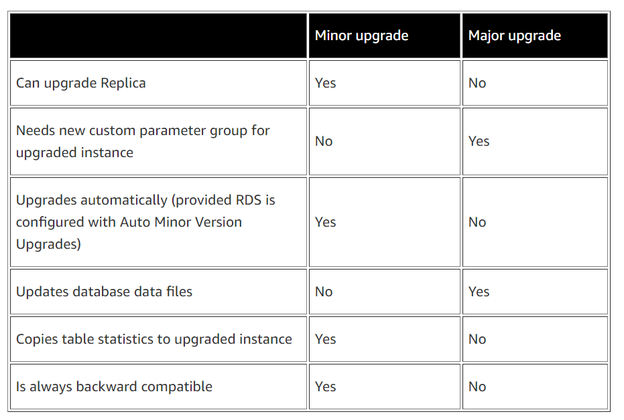
Differences between Major and Minor version upgrades
More: https://docs.aws.amazon.com/AmazonRDS/latest/UserGuide/USER_UpgradeDBInstance.Upgrading.html

Slide 8
RDS version lifecycle
RDS version lifecycle usually follows the engine developer’s own lifecycle of releases, security fixes, and deprecation
Major Version
Supported at least 3 years
When deprecated - RDS provide a minimum six (6) month period after the announcement of a deprecation for you to initiate an upgrade to a supported major version.
Minor Version
Supported at least 1 year
When deprecated - RDS provide a three (3) month period after the announcement before beginning automatic upgrades
Major or Minor DB version is no longer supported in Amazon RDS
Any DB instance restored from a DB snapshot will automatically and immediately be upgraded to a currently supported version.
Notes:
https://www.postgresql.org/support/versioning/
Q: Does Amazon RDS provide guidelines for support of new DB engine versions?
Over time, Amazon RDS adds support for new major and minor database engine versions. The number of new versions supported will vary based on the frequency and content of releases and patches from the engine’s vendor or development organization, and the outcome of a thorough vetting of these releases and patches by our database engineering team. However, as a general guidance, we aim to support new engine versions within 5 months of their general availability.
https://aws.amazon.com/rds/faqs/
Q: Does Amazon RDS provide guidelines for deprecating database engine versions that are currently supported?
We intend to support major version releases (e.g., MySQL 5.6, PostgreSQL 9.6) for at least 3 years after they are initially supported by Amazon RDS.
We intend to support minor versions (e.g., MySQL 5.6.37, PostgreSQL 9.6.1) for at least 1 year after they are initially supported by Amazon RDS.
Periodically, we will deprecate major or minor engine versions. For major versions, this is typically when the version has moved to extended support or is no longer receiving software fixes or security updates. For minor versions, this is when a minor version has significant bugs or security issues that have been resolved in a later minor version.
While we strive to meet these guidelines, in some cases we may deprecate specific major or minor versions sooner, such as when there are security issues. In the unlikely event that such cases occur, Amazon RDS will automatically upgrade your database engine to address the issue. Specific circumstances may dictate different timelines depending on the issue being addressed.

Slide 9
Auto Minor Version Upgrade (AMVU)
The RDS for each engine defines their rules and schedules
Review RDS Documentation
The database is running a minor version of the DB engine that is lower than the preferred minor engine version
The database has auto minor version upgrade enabled
Verify AMVU using AWS CLI
describe-pending-maintenance-actions
apply-pending-maintenance-action
Example: Minor Upgrades (like RDS PostgreSQL 9.5.2-R1 to 9.5.4-R1) might be applied automatically during the maintenance window
Customers are highly encouraged to manually test and patch up to keep up with patches/fixes
More: https://aws.amazon.com/blogs/database/best-practices-for-upgrading-amazon-rds-to-major-and-minor-versions-of-postgresql/

Slide 10
Upgrade Pre-Checks
The customer should, for all upgrades
Review RDS Documentation
Do a dry run (test) of the upgrade process, and
Do Functionality Testing for compatibility with customer’s application code
Do Performance Testing for compatibility with customer’s application code
This can be accomplished by creating an upgrading a Read Replica
Ensure sufficient disk space is available
Upgrade Read Replicas before Master
Additionally, for Major Version Upgrades
Create parameter and options groups
Read engine developer’s documentation on the differences between versions

Slide 11
Production Upgrade Steps
The customer
Can take a backup one hour before the upgrade
This reduces upgrade downtime, while application is down
This also ensures faster PITR to time close to upgrade
Should ensure there’s no long running transaction open
Stops/blocks application writes to database (avoids lost data in case of PITR)
Issues upgrade API call to RDS
RDS
Takes a backup before and another after upgrade
Executes all technical steps as dictated by Engine Developer’s documentation

Slide 12
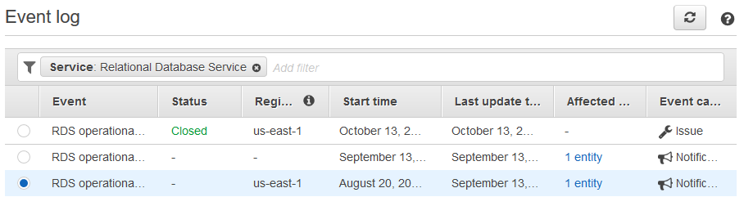
How do you maintain the database? How can I plan for it?
Any maintenance that causes downtime (typically only a few times per year) will be scheduled in your maintenance window
Operating system or Amazon RDS software patches are usually performed without restarting databases
Database engine upgrades require downtime
Minor version upgrades—automatic or manually applied
Major version upgrades—manually applied
Version deprecations—three- to six-month notification before scheduled upgrades
View upcoming maintenance events in your AWS Personal Health Dashboard

Slide 13
Common problems during Upgrade
Sometimes RDS Postgres upgrade encounters certain issues
pg_upgrade.log contains details of these issues
Error | Reason
INCOMPATIBLE_PARAMETER | Could occur if a memory-related parameter such as shared_buffer or work_memory was set too large
STORAGE_FULL | Instance ran out of space
Logical Replication slots | If the database is using logical replication slots

Slide 14
Common problems during Upgrade
Error | Reason
Release Date Dependency | If the release date of the target version is older than the release date of the current version
Master User name | If master user name starts with pg_, the upgrade fails
Upgrades taking long time | The duration is dependent on the number of database objects not their physical size
Slowness after the upgrade | Optimizer statistics are not upgraded to they need to be re-gathered after the upgrade by running ANALYZE. Hence this time has to be accounted in the over all upgrade time line
Blog: https://aws.amazon.com/blogs/database/best-practices-for-upgrading-amazon-rds-for-mysql-and-amazon-rds-for-mariadb/
Notes:
Check the latest cases on upgrade related issues for RDS PostgreSQL
https://command-center.support.aws.a2z.com/case-console#/case-search

Slide 15
Thank you!

